Slide 1
College of Western Idaho SWDV 210 Introduction to Server Side Programming
Week 1 Day 1

Slide 2
Student Introductions
Name
Where you work
Any concerns about this class?
Previous experience with PHP?

Slide 3
SWDV 210 – Day 1 Agenda
Project 1
Setup Work Environment
Install XAMPP
Configure PHP
Install NetBeans IDE
Install Exercise files
Load Databases
Day 1 Topics
Demonstration
Day 1 Lab

Slide 4
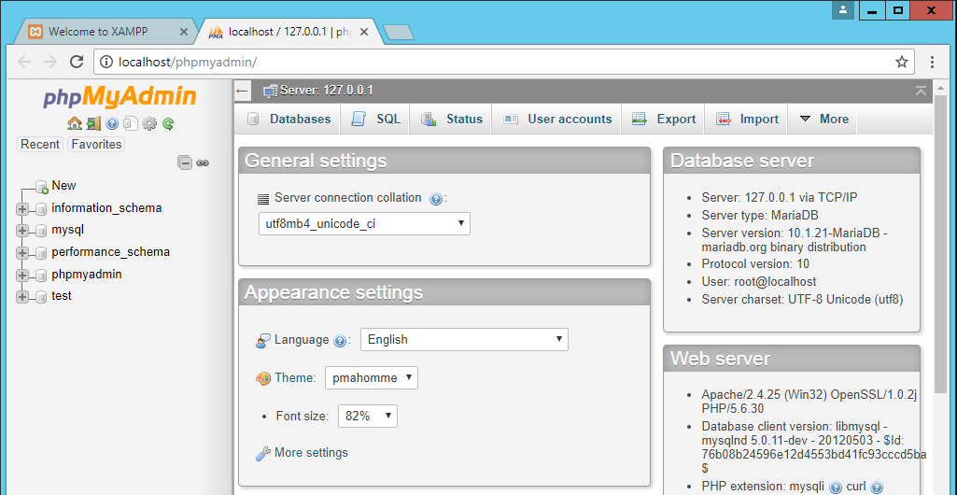
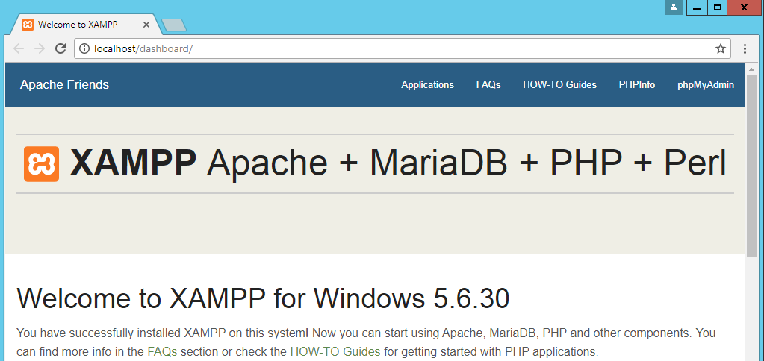
Setup Work Environment
RDP to your Hyper-V Server:172.22.4.1xx
Virtualization platform that is included in Windows
Login using your WEBDEV.CLASS credentials AFTER 1st login
Offsite RDP to www.w3expressions.com:194xx
Install XAMPP
Copy SWDV210-ISO.zip from host c:\updates to HV downloads & unzip
Right Click (RC) xampp-win32-5.6.30-1-VC11-installer & run as administrator | Next | Next | Next | uncheck Learn more | Next | Next | Start Control Panel | Finish | USA Save
Install as Service: Apache & MySQL – click red X
Start both
Connect to both Admin panels
Notes:
Fall semester: Server:172.22.2.1xx
Spring: Server:172.22.4.1xx

Slide 5
Setup Work Environment
Configure PHP
Edit C:\xampp\phpMyAdmin\config.inc.php using WordPad
Change the following & save:
$cfg['blowfish_secret'] = '1360SouthEagleFlightWayBoiseIdaho';
$cfg['Servers'][$i]['auth_type'] = 'cookie';
$cfg['Servers'][$i]['user'] = '';
Close Admin browsers & restart in XAMPP Control Panel
Login to phpMyAdmin with root & null pw
change pw to ‘Pa$$w0rd’
Must be 32+ chars

Slide 6
Setup Work Environment
Install NetBeans IDE
In ISO folder, RC netbeans-8.2-php-windows-x64.exe & run as admin | Next | accept Next | Next | uncheck Install | uncheck Finish
Install Exercise Files
In ISO folder, RC php2_allfiles.exe, on php2_allfiles & run as admin | Unzip
Load Databases
Login to phpMyAdmin | Import | Choose File | navigate to C:\xampp\htdocs\book_apps\_create_db\create_db.sql | Open | Go
Allow HTTP traffic
Control panel | Windows Firewall | Advanced Settings | Inbound Rules | New | Port | Next | TCP 80, 443 | Next | Save
Install Chrome

Slide 11
Notes:
WAN: wide area network
IXP: internet exchange point

Slide 20
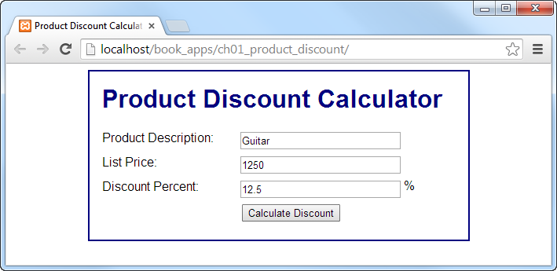
Notes:
Start NetBeans | File | Open | navigate to C:\xampp\htdocs\book_apps\ch01_product_discount | Open Project

Slide 21
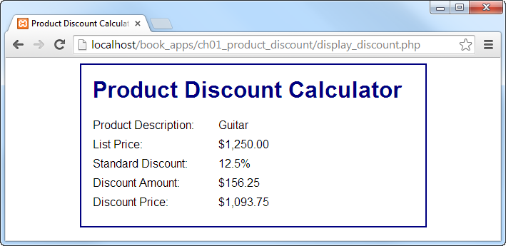

Slide 29
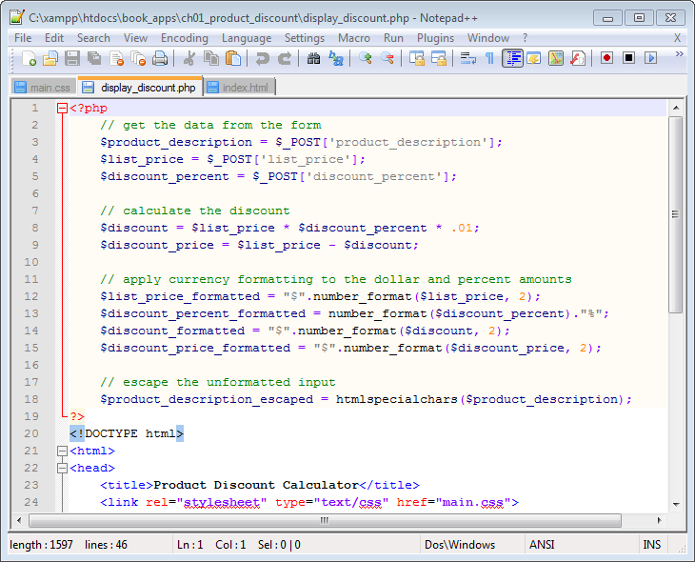

Slide 33
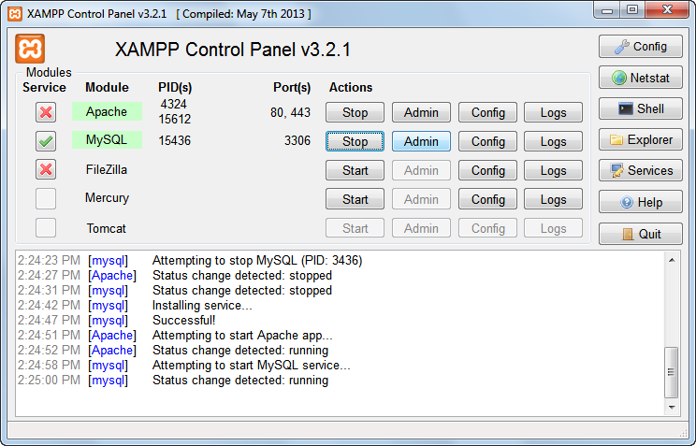

Slide 40
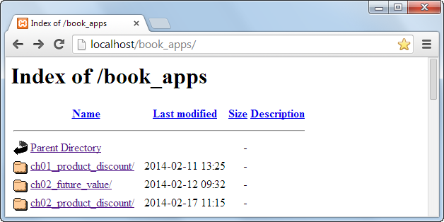

Slide 41
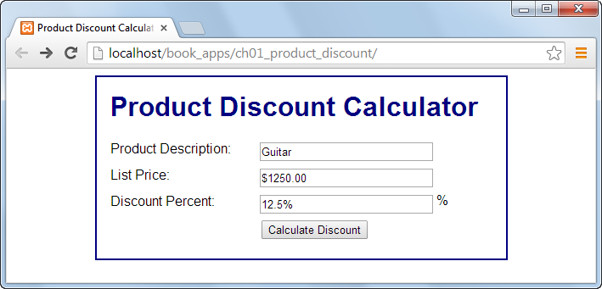

Slide 42
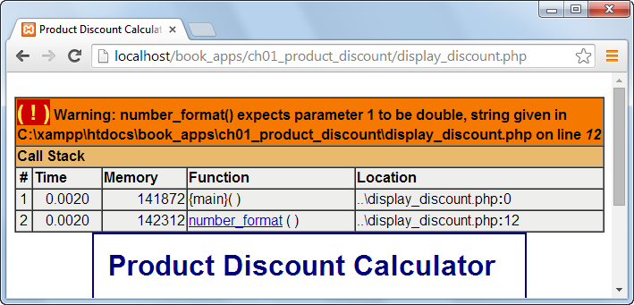

Slide 44
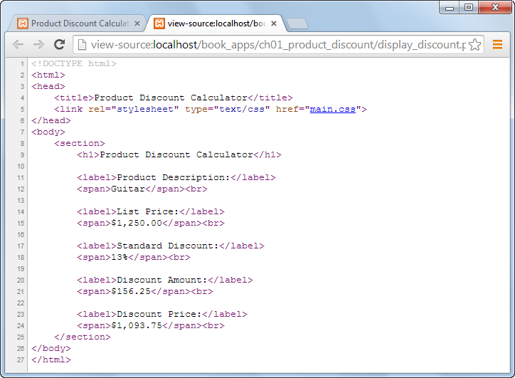

Slide 46
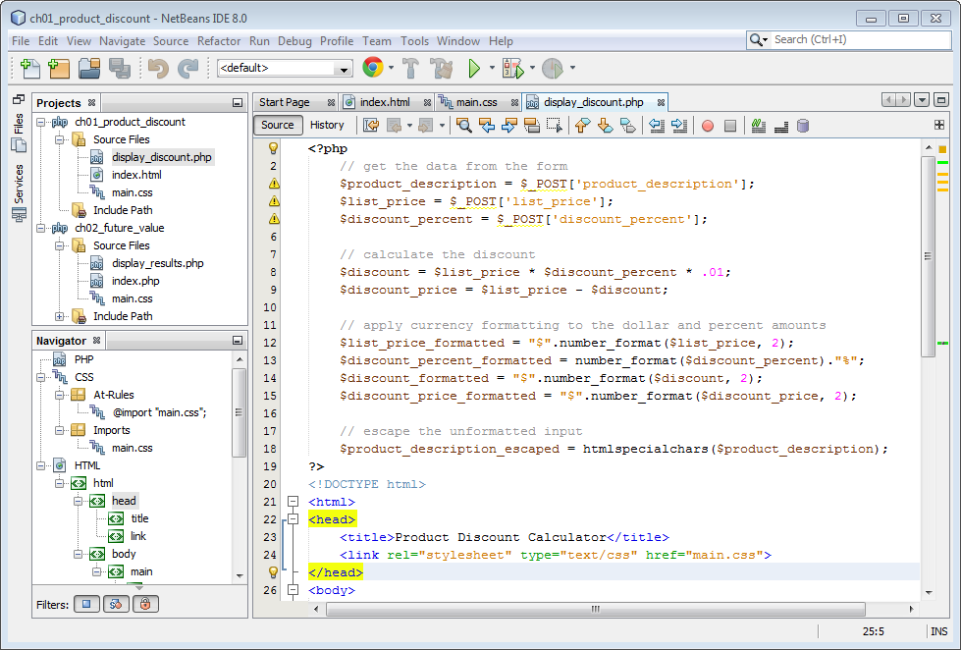

Slide 49
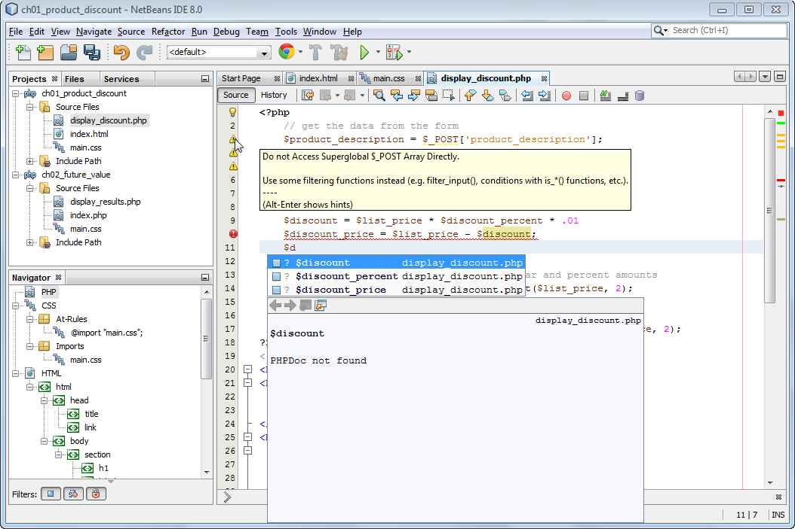
Warning icons
Error icon
Auto-completion list for names that start with $d

Slide 51
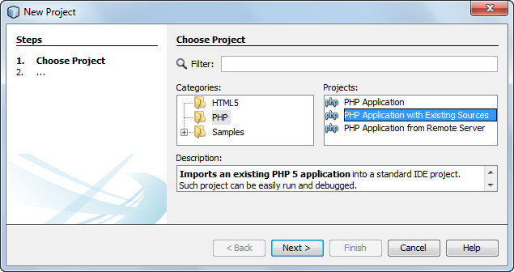

Slide 52
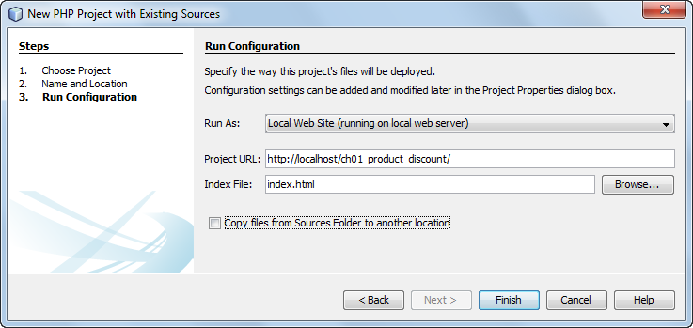

Slide 54
SWDV 210
Questions?

